Slide 1

The B.O.M.: Chiel Peters, Cindy Berghuizen, Mary Gouseti, Omar Pakker
Software Architecture
Review of W1's Architecture

Slide 2

Overview
Conclusions from questions
  Capturing stakeholder's concerns
  Identifying requirements & decisions
  Reviewing the choice of viewpoints
Scenarios
  Decoupling B2B/ B2C
  Peak-load on analytics module
Analysis
The B.O.M.

Slide 3
  Capturing Stakeholder Concerns
Capturing Stakeholder Concerns
All stakeholders and their roles are stated
Not all stakeholder concerns are listed
Not all listed concerns are properly addressed
  Some are just briefly mentioned
No concern prioritization
The B.O.M.

Slide 4
  Identifying requirements & decisions
Identifying requirements & decisions
Business goals are nicely presented and associated with the stakeholders.
In contrast, functional requirements are only briefly stated, and their priority is unclear.
Mapping between decisions and requirements.
Time schedule was strictly defined.
Cost was not analyzed to the same extend.
The B.O.M.

Slide 5
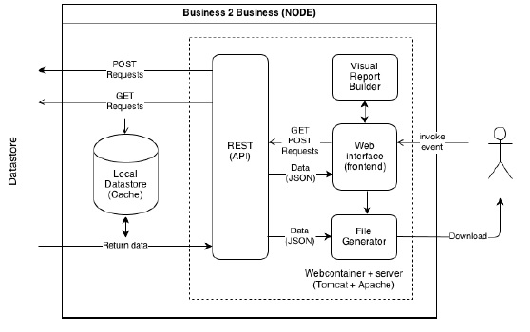
Reviewing the choice of viewpoints
The B.O.M.

Slide 6
Scenarios – Decoupling B2B / B2C
Attribute | Availability
Environment | Normal operations
Stimulus | B2B or B2C failure
Response | Failure of either one does not influence the other.
 | Architectural Decision | Sensitivity | Trade-off | Risk | Non-risk
 | Decoupling | S1 | T1
 | Different API | S1 | T2 |  | N1
 | S1: If both modules run on the same server they will still fail if the server crushes. T1: May lose similar requests' optimization => Performance vs Availability. T2: Redundant code => Modifiability vs Availability. N1: There is no single point of failure.
Reasoning | Decoupling B2B/ B2C => B2B fails B2C stays unaffected and vice versa.
The B.O.M.

Slide 7
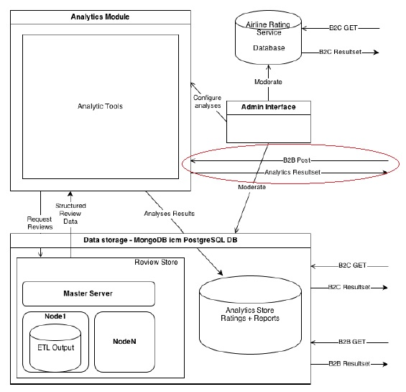
Scenarios – Peak Load Analytic Module
The B.O.M.

Slide 8
Scenarios – Peak Load Analytics Module
Attribute | Performance
Environment | Normal operations
Stimulus | Recalculating ratings/ reviews
Response | B2B latency < 10 sec.
 | Architectural Decision | Sensitivity | Trade-off | Risk | Non-risk
 | Recalculate 1-2 times a day (Implicit) |  |  | R1
 | B2B accesses analytics directly (Implicit) |  | T1
 | R1: Recalculating creates a peak load on the analytics module which may increase B2B latency. T1: Custom queries => Functionality vs Performance and even availability.
Reasoning | Recalculating on a time frame + Direct access to analytics => Undesirable response time
The B.O.M.

Slide 9
Analysis
The question sets really helped to focus on what was missing or was not explicitly stated.
ATAM's scenarios helped to identify risks and evaluate a decision on a more solid basis.
The B.O.M.

Slide 10

Questions?
Ball of Mud is a reference to the Software Architecture
“Big Ball of Mud”.
This is an architecture without a clear structure.
The B.O.M.

